Slide 1
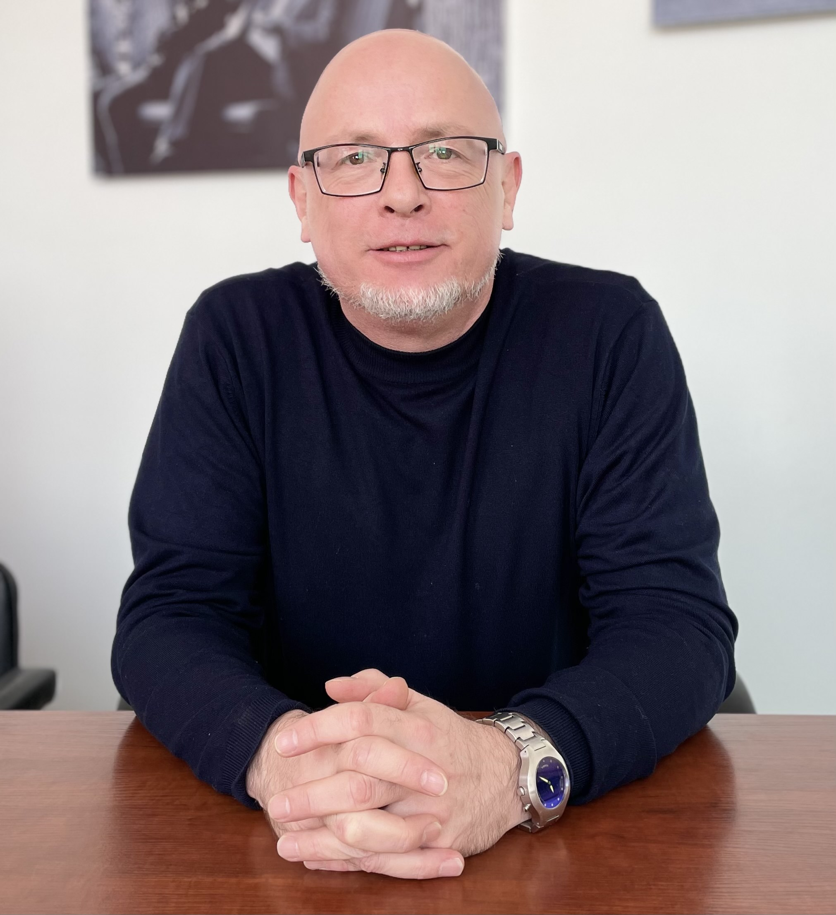
cultural change as the foundation of higher education transformation
Ewan Simpson, PhD
Dean, School of Digital Technologies
Narxoz University
April 2021
RUMS 2021 Online Conference: Transformation of education: methodologies, paradigms and perspectives

Slide 2
introduction
What are we really talking about when we talk about transforming higher education? Relevance? To whom? Quality? Who defines that?
What do we want to transform higher education into?
If we can’t answer that we won’t get very far
We can assume that the goal is to be positioned organizationally to achieve international accreditation as a badge of international quality
To have programs which are seen as ‘relevant’
To produce research which is seen as ‘relevant’ and publishable
cultural change and governance are the foundation
programs and research are the output
Focus here is at the input and process level – finances, culture, governance, faculty development
Make some recommendations which could lead to a genuine transformation

Slide 3
contents
defining transformation
components of the process
financial choices
structural inefficiencies
faculty
program relevance
culture and governance

Slide 4
what do we mean by transformation
a complete change in the appearance or character of something or someone, especially so that that thing or person is improved (Cambridge Dictionary)
change
improvement
so ‘transformation of education’ means ‘changing education to improve it’
we are talking about the transformation of the sector, not a small number of elite institutions.
Recommendation: clearly define what we mean by transformation

Slide 5
components of the process
finance
faculty
programs
students facilities and learning resources
research
the foundation for all of the above - culture and governance
focus here on finance, faculty, programs, culture and governance

Slide 6
financial choices
conventional wisdom is that if we spend more on something it will be better
so is more money the answer?
some context is important
the majority of universities in Kazakhstan are private and get most of their funding from tuition fees
average tuition fees are approximately one third of the official annual salary
on the same measure, for example, UK university fees are one quarter of the average annual salary

Slide 7
financial choices
in world leading education systems like the UK and USA, less than 50% of university income comes from direct tuition
stage 1 is diversifying - and increasing - income
If investment is part of the answer, tuition is already expensive when compared with income and accounts for a higher share of university revenue than world class systems

Slide 8
financial choices
additional state support for core costs
expanded corporate support
greater success in attracting international funding
over time build endowments
the reality is that the state would be the main source - note that the OECD average public sector share for higher education expenditure is 68%, for the EU 73%. For the much admired Scandinavian countries, it ranges from 80-99%
nothing ‘wrong’ in that in that it is investment in a public good

Slide 9
financial choices
Kazakhstan has made two critical choices – to be a low direct taxation society and (historically at least) to invest less in higher education as a proportion of public spending than other countries. So priorities could shift if there was the will to invest without increasing overall spending
if more money is the answer - for universities – need to change the business model, since tuition is already expensive when compared with consumer incomes and accounts for a higher share of university revenue than world class systems
Recommendation : Transformation cannot happen without revisiting financial priorities – at state and university level

Slide 10
structural inefficiencies
funds are limited
even if they were to grow, does it make sense for Kazakhstan to have almost as many universities as the UK with less than one third of the population?
not an argument for having less higher education, but an argument for efficiency of delivery
even the most efficient universities have high indirect costs
Recommendation 2: build a lean business model for a smaller number of larger universities which embrace quality online elements

Slide 11
faculty
if there was more money available, what should it be invested in?
this is the heart of the matter and goes deep into understanding what drives the development of quality in universities
the fundamental factor in transformation is the quality of the faculty developing and delivering education programs and carrying out research.
infrastructure is politically acceptable
Is investment in human capital equally so?

Slide 12
faculty
if we accept there is a need to transform the higher education system and that faculty are at the core of this process
does it make sense to expect faculty – the vast majority of who were trained in previous iterations of that same system – to drive transformation without a major change?
only three ways to change
major investment in the professional development of the existing faculty
recruitment of new faculty who are a better ‘fit’ with the system transformation aims to develop
retire those who are not able to transform

Slide 13
faculty
even if universities had additional funds, achieving this would demand a major reorientation of spending priorities inside universities
to investment in intensive professional development (knowledge base and skills development)
develop revised compensation systems to retain those trained (and the value of their training) by paying them more…
….and to attract new faculty who can contribute to the ongoing transformation of the system
Recommendation: attract, invest in and retain high quality faculty

Slide 14
programs - relevance
employers regularly complain about ‘relevance’ and ‘practicality’
what employers often mean is saving time and money on training, passing the costs to the state or the student
there is a place for job specific skills, for example in IT, law and business, engineering and medical education
these specifics can be dangerous without context – and remember – the Soviet education system was all about specialization

Slide 15
programs - relevance
the employer voice is loud but often contradictory, since almost all surveys list non-profession specific qualities as the most desirable - critical thinking, flexibility, problem solving, independent thought and collaboration
there is an argument to be made that being’ student-centered’ cannot just be about providing job-related training and knowledge
but equipping students with skills and knowledge that will help them develop as people independent of a particular career path.

Slide 16
programs - relevance
the reality is that many of the professions arguing for ‘off the shelf’ graduates will employ far fewer people in future
universities need to be focused on training for a future we don’t know.
what is ‘relevant’ if we accept we don’t have a crystal ball?
perhaps the time has to come take a step back, be confident and make the case that education not directly related to specific current professions is also relevant and practical

Slide 17
programs - relevance
educational leaders need to step up, make the argument and not contradict themselves (i.e. emphasize creative thinking vs. job ready)
why waste time on skills and knowledge that will be redundant in a few years? How is that student centered?
train students to understand how the world is as it is - how we got here, where we are and where we are headed, providing a context for the professionally-specific element.

Slide 18
programs - relevance
develop this knowledge base while adopting learning techniques that build critical thinking, flexibility, problem solving, independent thought and collaboration
Recommendation: be clear on what developing a modern relevant curriculum means

Slide 19
culture and governance
Building a culture and governance system is fundamental to success
hire well and invest in faculty
leave them alone to do what you hired them for
“It doesn't make sense to hire smart people and tell them what to do; we hire smart people so they can tell us what to do.” (Steven Jobs)

Slide 20
culture and governance
most faculty will tell you they want to work in an environment where they
..are free to express themselves…
…are involved in decisions that affect them…
..have some say over what and how they teach..

Slide 21
culture and governance
..are trusted by their managers to deliver well on what they are asked…
…have interesting work colleagues…
have opportunities for professional and personal development both as teachers and researchers ….
…..have good students to work with.
while compensation is important, this is not the only consideration.

Slide 22
culture and governance
current challenges have little to do with the intellectual potential of the people who work in universities …
…witness the success of those who have left and experienced other university cultures in Kazakhstan and internationally…
…but it has a lot to do with the culture of the universities in which they learned and now work…

Slide 23
culture and governance
…in many cases, these organizations do not provide a positive environment for growth and development…
…as a result, they struggle to attract precisely the kind of people they need to be successful.

Slide 24
culture and governance
a top down ‘command and control’ management does not work in a creative environment like a university
people do nothing more than they are told since there is limited encouragement or reward
universities cannot attract the best people because they are not investing in people, compensating them appropriately or – crucially - providing an environment faculty will thrive in
Recommendation: build a culture and governance system which is inclusive, democratic, faculty-led and based on mutual trust

Slide 25
the takeaway
Recommendation I : clearly define what we mean by transformation
Recommendation II : transformation cannot happen without revisiting financial priorities –at state and university level
Recommendation III: attract, invest in and retain high quality faculty
Recommendation IV: be clear on what developing a modern relevant curriculum means
Recommendation V: build a culture and governance system which is inclusive, democratic, faculty-led and based on mutual trust

Slide 26
thanks for your time
ewan.simpson@narxoz.kz

Slide 27
Draft notes
try to ffer an altenrative perspepctive
think of structural rather than superficial issues
Inputs rather than outputs
beginning middle and end of transformation in higher education is the development of high quality faculty
Basic argument – Bolashak is the right approach, but nothing serious has of yet been put in place otproviude a platform for returning graduates to fully engage with higher education
This is becyuase very little has been done to re-orient universities to where they should be
Faculty driven - not th elow pay, low quality environment we find in most universities
Moist of you don’t want to her it because you are the status quo
But I am also the status quo having been in KZ for almost 17 years and I can say that no university has succeeded in developing the kind of culture that will nurture a high quality faculty.
Workloads are high, there is no encouragement or avenue for quality research, the command and control culture remains and involvement in governmenrac eis tokentic rubber stamping
Comnpensaiton is low due to insane tuition levels and there is no way to build quality universities without attractinbg the right kind of people which cannot happen without a step change in income levels.
The last 30 years have bene wasted in HE and the only way forward is to begin now to build an effective university culture. What might that look like
The approach has been like investing in football players and doing nothing to improve facilities so they can succeed and expecting them to work for 10% of the income the people they learned with. .

